Slide 1
CMR and EU Private International Law
Erik Sinander and Joel Husberg
September 20, 2024

Slide 2
What is private international law?
Jurisdiction
Applicable law
Enforcement of foreign judgments
Private international law is not uniform law

Slide 3
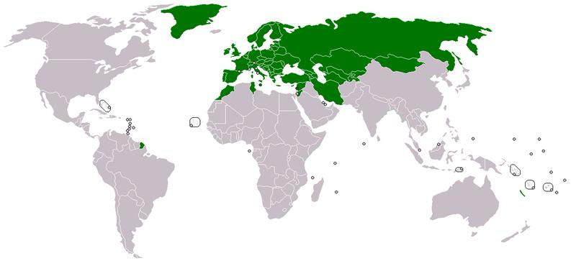
Private International Law Aspects of the CMR
Uniform rules for contract matters
Public international law
Applicable in 58 countries

Slide 4
International procedural law and the CMR (Jurisdiction and recognition/enforcement of foreign judgments)

Slide 5
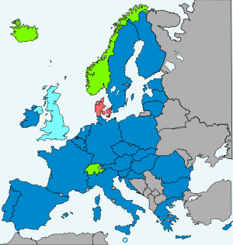
Brussels/Lugano Regime
- Uniform rules on jurisdiction and
recognition/enforcement of foreign
judgments in civil and commercial
matters
”Free movement of judgments”
- EU law
Applicable in 30 countries since 1968

Slide 6
Does CMR contain jurisdictional rules?
Article 31
1. In legal proceedings arising out of carriage under this Convention, the plaintiff may bring an action in any court or tribunal of a contracting country designated by agreement between the parties and, in addition, in the courts or tribunals of a country within whose territory:
(a) The defendant is ordinarily resident, or has his principal place of business, or the branch or agency through which the contract of carriage was made, or
(b) The place where the goods were taken over by the carrier or the place designated for delivery is situated.
2. Where in respect of a claim referred to in paragraph 1 of this article an action is pending before a court or tribunal competent under that paragraph, or where in respect of such a claim a judgement has been entered by such a court or tribunal no new action shall be started between the same parties on the same grounds unless the judgement of the court or tribunal before which the first action was brought is not enforceable in the country in which the fresh proceedings are brought.
3. When a judgement entered by a court or tribunal of a contracting country in any such action as is referred to in paragraph 1 of this article has become enforceable in that country, it shall also become enforceable in each of the other contracting States, as soon as the formalities required in the country concerned have been complied with. These formalities shall not permit the merits of the case to be re- opened.
4. The provisions of paragraph 3 of this article shall apply to judgements after trial, judgements by default and settlements confirmed by an order of the court, but shall not apply to interim judgements or to awards of damages, in addition to costs against a plaintiff who wholly or partly fails in his action.
5. Security for costs shall not be required in proceedings arising out of carriage under this Convention from nationals of contracting countries resident or having their place of business in one of those countries.

Slide 7
Conflicting attitudes to party autonomy
Party autonomy is one of the principles on which the Brussels I bis Regulation is built
The CMR does not fully accept party autonomy.

Slide 8
What jurisdictional rules shall be applied in a conflict?
Article 71 of the Brussels I Regulation
1. This Regulation shall not affect any conventions to which the Member States are parties and which, in relation to particular matters, govern jurisdiction or the recognition or enforcement of judgments.
2. With a view to its uniform interpretation, paragraph 1 shall be applied in the following manner:
(a) this Regulation shall not prevent a court of a Member State which is party to a convention on a particular matter from assuming jurisdiction in accordance with that convention, even where the defendant is domiciled in another Member State which is not party to that convention. The court hearing the action shall, in any event, apply Article 28 of this Regulation;
(b) judgments given in a Member State by a court in the exercise of jurisdiction provided for in a convention on a particular matter shall be recognised and enforced in the other Member States in accordance with this Regulation.
Where a convention on a particular matter to which both the Member State of origin and the Member State addressed are parties lays down conditions for the recognition or enforcement of judgments, those conditions shall apply. In any event, the provisions of this Regulation on recognition and enforcement of judgments may be applied.

Slide 9
How has the CJEU interpreted Article 71 in the Regulation’s relationship to the CMR?
TNT Express Nederland, C-533/08, ECLI:EU:C:2010:243
CMR will prevail if it accepts fundamental EU private international law principles.
Nippponkoa Insurance, C-452/12, ECLI:EU:C:2013:858
CMR must be interpreted in good faith.
Nickel & Goeldner Spedition, C-157/13, EU:C:2014:2145
Gjensidige, C-90/22, ECLI:EU:C:2024:252
May a MS refuse to enforce a judgment where a forum selection clause has been set aside with reference to CMR?

Slide 10
Choice of Law and the CMR

Slide 11
Shall the CMR be applied with or without choice of law rules?
What country’s law shall govern gap-filling issues and issues of reservations?
Two options: the law pointed out by choice of law rules or the law of the forum

Slide 12
CMR Convention
Article 1
1. This Convention shall apply to every contract for the carriage of goods by road in vehicles for reward, when the place of taking over of the goods and the place designated for delivery, as specified in the contract, are situated in two different countries, of which at least one is a Contracting country, irrespective of the place of residence and the nationality of the parties.
Examples of CMR’s relation to choice of law:
Article 16
5. The procedure in the case of sale shall be determined by the law or custom of the place where the goods are situated.
Article 28
1. In cases where, under the law applicable, loss, damage or delay arising out of carriage under this Convention gives rise to an extra-contractual claim, the carrier may avail himself of the provisions of this Convention which exclude his liability or which fix or limit the compensation due.

Slide 13
Shall the Rome I Regulation be applied?
Article 25
Relationship with existing international conventions
1. This Regulation shall not prejudice the application of international conventions to which one or more Member States are parties at the time when this Regulation is adopted and which lay down conflict-of-law rules relating to contractual obligations.
2. However, this Regulation shall, as between Member States, take precedence over conventions concluded exclusively between two or more of them in so far as such conventions concern matters governed by this Regulation.

Slide 14
Does the CMR lay down conflict-of-law rules or is it solely a substantive law convention?
Swedish Supreme Court’s judgment NJA 2022 p. 469 (Cigarettpunktskatten)
Are the judgments regarding the Brussels I Regulation relevant for choice of law?

Slide 15
Conclusions
CMR’s relation to choice of law is a conflict of methods
Both PIL and CMR contain a common objective in achieving international harmony.
Don’t miss the forest for all the trees!

