Slide 1
Is Excise Duty recoverable under Article 23(4) CMR? –
The JTI Polska decision
Dr. Simone Lamont-Black
Edinburgh Law School
CMR Colloquium 2024
Uniform Interpretation of the CMR
Stockholm - 19 September 2024

Slide 2
Content of this Presentation
Purpose of limitation regime in transport
Excise duty as part of the monetary limitation of liability regime?
Excise duty in the UK Supreme Court –
  JTI Polska v Jakubowski and Buchanan
  Conclusions from the UK
Should excise duty be recoverable?
Conclusions more broadly

Slide 3

The Purpose of Monetary Limitation in Shipping and Transport?

Slide 4
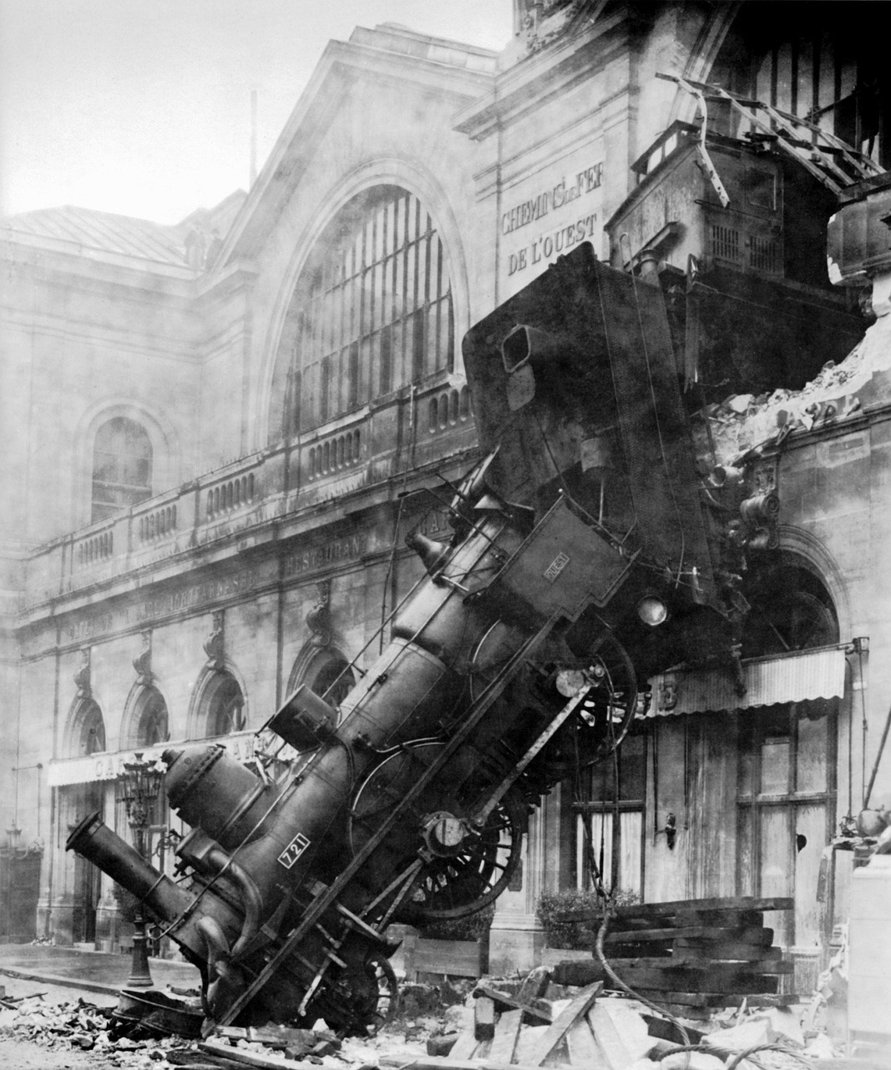
The Purpose of Monetary Limitation in Shipping and Transport?
Carriers Act 1830, section 1:
Mail contractors, coach proprietors, and carriers not to be liable for loss of certain [high value] goods above the value of 10 Pounds, unless they are delivered as such, and increased charge accepted.
Includes list of valuable and tradable items.

Slide 5
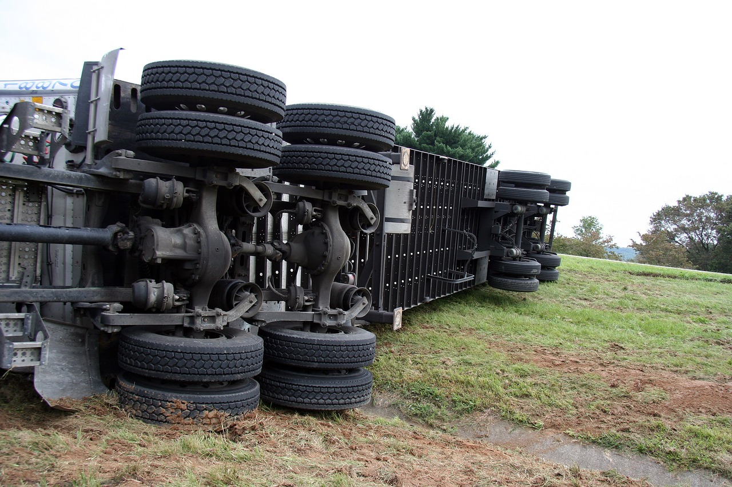
The Purpose of Monetary Limitation in Shipping and Transport?
Shipping as business:
  Damages, to ensure good care - interest in safe arrival of goods
  Not insurer – disconnect from any high value of goods
  Limitation - calculate exposure - allow insurability
Cargo benefits from goods’ value:
  Declare value - against payment
  Additional exposure more economically covered by cargo- not liability- insurance

Slide 6
The System of Monetary Limitation in Shipping and Transport
Sea and inland waterways - damages:
    Goods’ value at arrival port – place and time of discharge
    Includes costs of carriage and other charges to reach destination
CMR and CIM - damages:
    Goods’ value of goods at time and place of acceptance for carriage
    Needs to add on carriage and other charges to reach destination
    Does this include excise duty? Falling within Art 23(4) CMR?

Slide 7
The CMR System of Monetary Limitation
Article 23
When, under the provisions of this Convention, a carrier is liable for compensation in respect of total or partial loss of goods, such compensation shall be calculated by reference to the value of the goods at the place and time at which they were accepted for carriage.
The value of the goods shall be fixed according to the commodity exchange price…
Compensation shall not, however, exceed ….
In addition, the carriage charges, Customs duties and other charges incurred in respect of the carriage of the goods shall be refunded in full in case of total loss and in proportion to the loss sustained in case of partial loss, but no further damage shall be payable.
In the case of delay ...
Higher compensation may only be claimed where the value of the goods or a special interest in delivery has been declared in accordance with articles 24 and 26.

Slide 8

JTI Polska v Jakubowski
[2023] UKSC 19

Slide 9




JTI Polska v Jakubowski
Poland
England

Slide 10
JTI Polska Sp Zoo v Jakubowski [EWHC]
- The High Court
CMR, art 23(4) – other charges incurred in respect of the carriage of the goods
  Bound by House of Lords (1978): Buchanan v Babco Forwarding and Shipping (UK) Ltd
    Excise Duty payable for whisky in the jurisdiction - recoverable
Wrong? Conflicting decisions causing uncertainty:
  European authorities
  Court of Appeal (2003): Sandeman Coprimar SA v Transitos y Transportes Integrales SL
    Guarantee payments due to loss of tax seals - not recoverable
  Leapfrog appeal – sufficient public importance

Slide 11
JTI Polska v Jakubowski [UKSC]
- The Supreme Court
A pragmatic decision!
Not really about Art 23 (4) CMR; instead:
About the 1966 HL Practice Statement:
  Very high threshold must be achieved before established authority ought to be overturned
  Even higher for questions of interpretation
  Purpose preserve legal certainty and shutting out opportunistic claims
Preservation of precedent as “indispensable foundation” of the common law

Slide 12
The 1966 Practice Statement
“Their Lordships regard the use of precedent as an indispensable foundation upon which to decide what is the law and its application to individual cases. It provides at least some degree of certainty upon which individuals can rely in the conduct of their affairs, as well as a basis for orderly development of legal rules.
Their Lordships nevertheless recognise that too rigid adherence to precedent may lead to injustice in a particular case and also unduly restrict the proper development of the law. They propose, therefore, to modify their present practice and, while treating former decisions of this House as normally binding, to depart from a previous decision when it appears right to do so.
In this connection they will bear in mind the danger of disturbing retrospectively the basis on which contracts, settlements of property and fiscal arrangements have been entered into and also the especial need for certainty as to the criminal law.”

Slide 13
JTI Polska [UKSC] -
1966 Practice Statement Threshold
Prior decision being wrong – not enough
Additional elements; e.g. previous decision must
  “generally thought to be impeding the proper development of the law or to have led to results which were unjust or contrary to public policy”
  “have created uncertainty in the law”
  Since decision “material change in circumstances”
  Re trade law convention, “that decision has been demonstrated to work unsatisfactorily in the market place and to produce manifestly unjust results”
Even higher for questions of interpretation
  Different minds having different opinions – decision must be untenable or manifestly wrong
  Finality of decision to avoid repeat litigation

Slide 14
JTI Polska [UKSC] -
Applying the 1966 Practice Statement
To be successful, appellants had to show:
  that Buchanan (the decision to be departed from) was untenable or manifestly wrong; AND
  that it was an appropriate case for Supreme Court to exercise its power under 1966 Practice Statement
Broad interpretation or “other charges” untenable?
  No consensus or uniformity across CMR states
    Albeit, impact of Buchanan ignored
In any event, no appropriate case
  Market had adjusted
  Other solutions - change by CMR Protocol
    Albeit, realism of this solution ignored

Slide 15

Conclusion on JTI Polska

Slide 16

The Purpose of Excise Duty?

Slide 17
The Purpose of Excise Duty?
Who should bear the burden of shipping goods, which have detrimental impact on health and public life?
Whose business model (price) includes the specific characteristics and the high value of the goods (that are subject to transportation)?
Who is intended to be addressed by excise duty?
Who should benefit from the limitation of liability provided by shipping laws?

Slide 18

The Purpose of Excise Duty
The World Health Org.:
“Excise taxes are the most effective tax measure for promoting health because they change the price [of] a harmful product relative to other goods and can be easily increased over time.”

Slide 19
Conclusions
Should other courts follow JTI Polska v Jakubowski?
NO – it is NOT a decision on excise duty
Should other courts feel restricted by Buchanan?
NO - if any, JTI Polska v Jakubowski underlined that Buchanan is a decision subject to valid criticism
Civil courts (at least) – take as open door for (re)interpretation
Wait for CMR Protocol? Unrealistic solution!
Should Excise Duty be recoverable?
NO - this is on cargo!
Cargo benefits from the characteristics of goods
There is no gap
Alignment with CIM – excise duty clearly excluded

Slide 20

The End

