Slide 1
Cargo bikes, H2-powered trucks and similar – are they covered by the CMR?
Prof. Dr. Tobias Eckardt

Slide 2
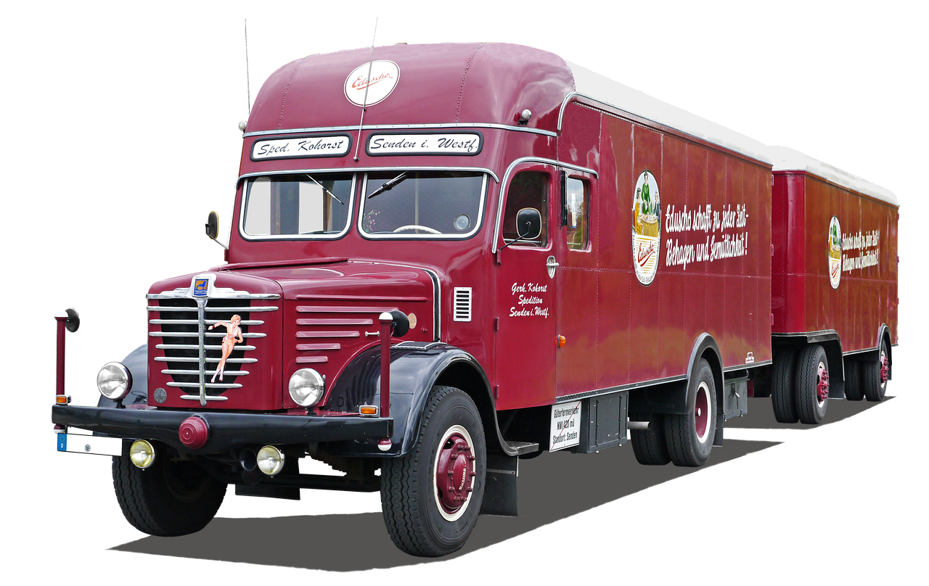
Back in 1956 life was easy …
pixabay.com/de/photos/büssing-8000s-lkw-1956-4050825/
Notes:
Back in the 1950s when the CMR was drafted, life was easier or at least we faced different questions. Back then, a truck looked like this and all was good

Slide 3
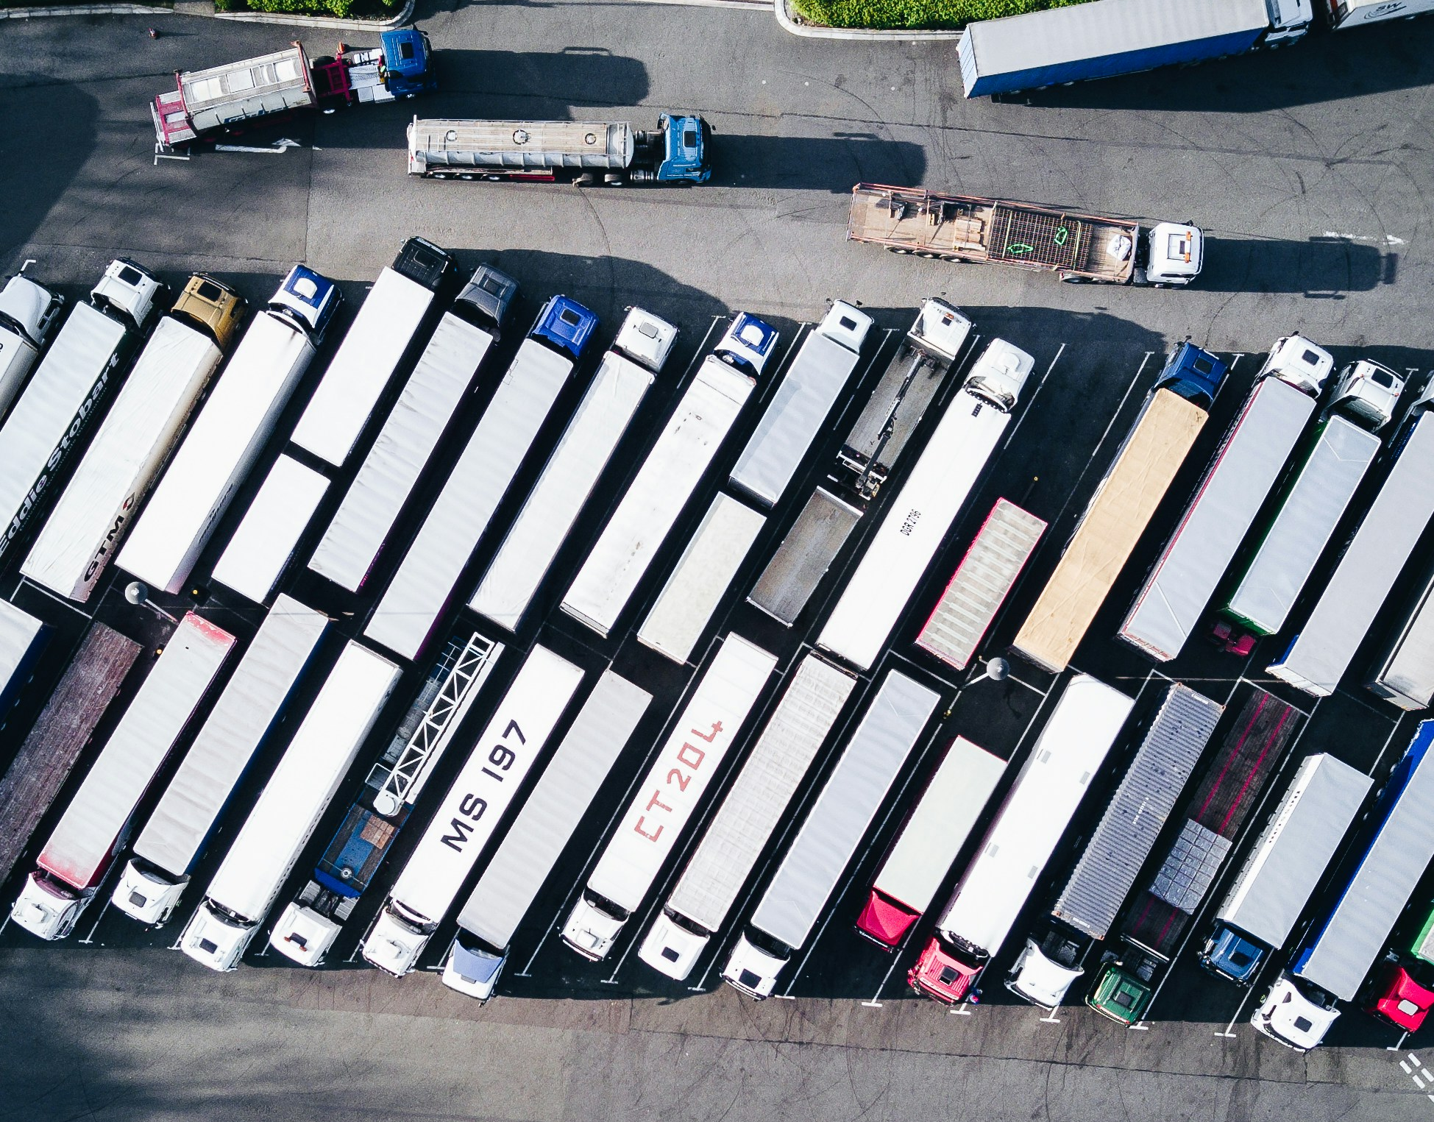
Photo by Nigel Tadyanehondo on Unsplash
Notes:
Trcuks developed further, containers came into play
Vehicle = truck
Container is not a vehicle

Slide 4
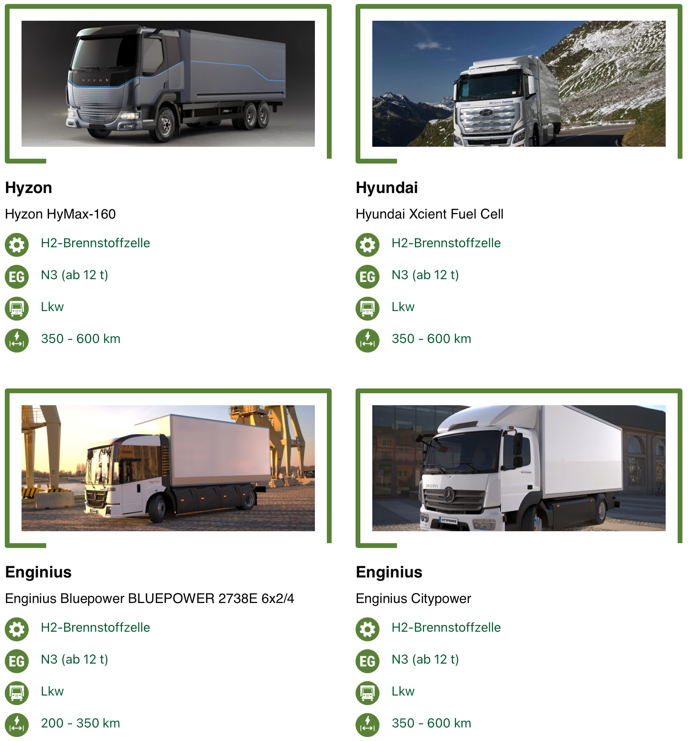
H₂ Fuel Cell
www.klimafreundliche-nutzfahrzeuge.de/fahrzeugdatenbank/?_sft_antriebsart=h2-brennstoffzelle&_sft_fahrzeugtyp=lkw
Notes:
Cliamte change and associated challanges brought a number of new concepts and ideas
Hydrogen fueled trucks, for example powered by fuel cells

Slide 5
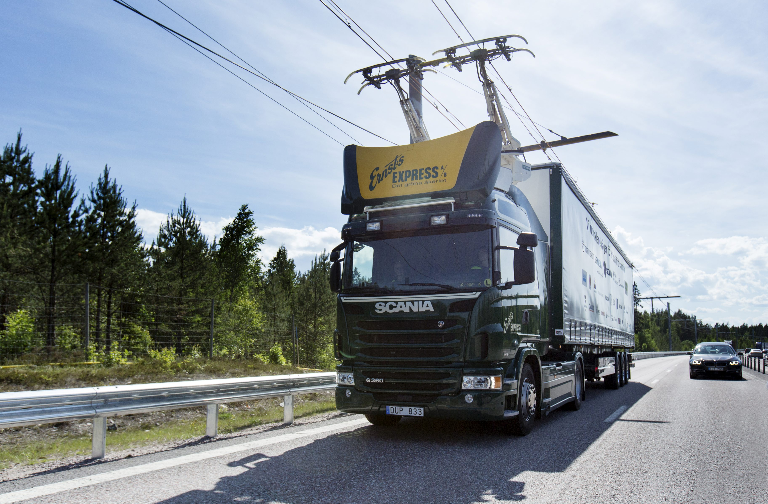
www.scania.com/group/en/worlds-first-electric-road-opens-in-sweden/
Notes:
Experiments with electric trucks
Here an example from Sweden, but we also have these elsewhere Germany

Slide 6
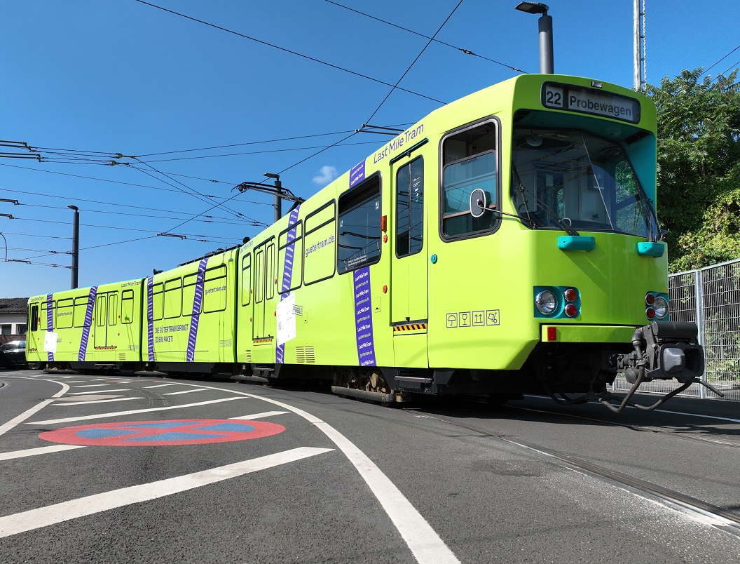
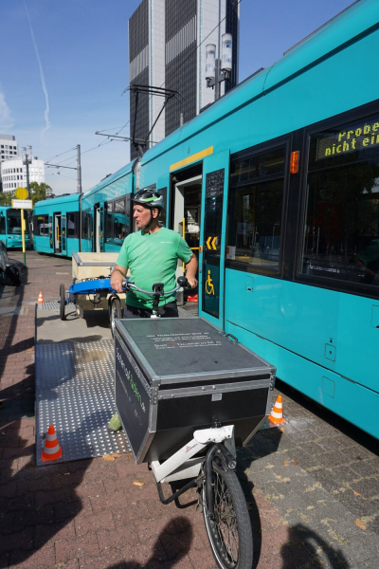
www.vgf-ffm.de/de/aktuelles/news/einzelansicht/achtung-hier-kommt-dein-paket-forschungsprojekt-zur-lastmiletram-gestartet
Notes:
Tram in Frankfurt as a mobile micro hub that delivers to cargo e-bikes

Slide 7
logistra.de/news/nfz-fuhrpark-lagerlogistik-intralogistik-auch-karlsruhe-liefert-ups-cargobike-15125.html

Slide 8
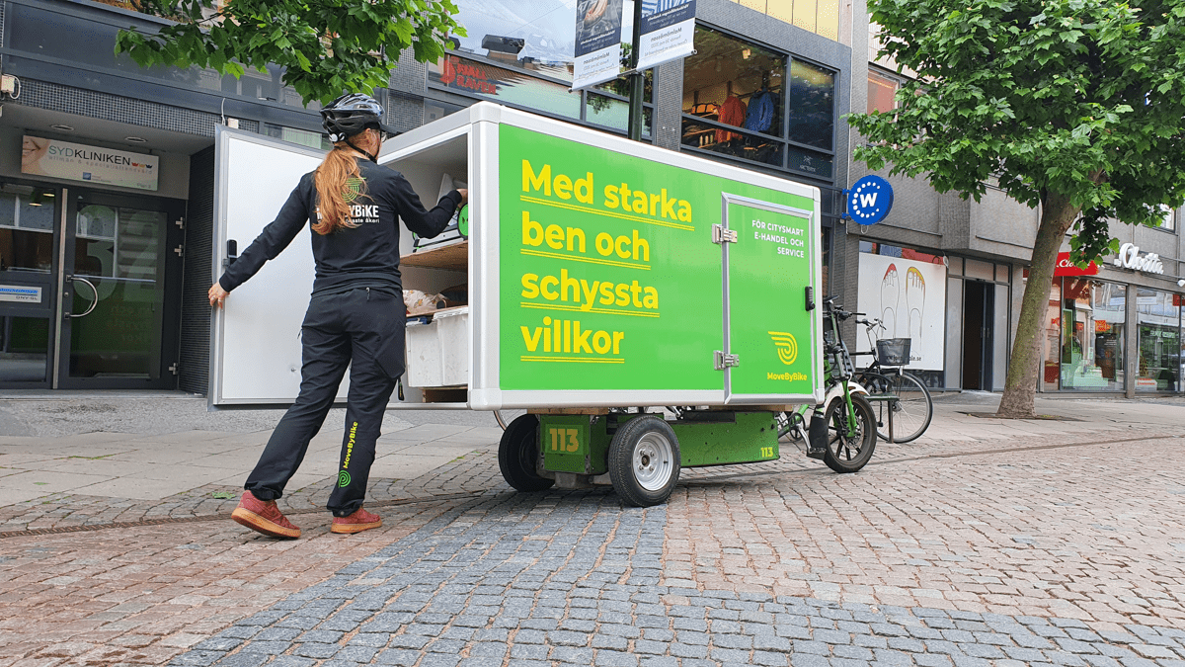
jobs.movebybike.com/departments/stockholm-riders
logistra.de/news/nfz-fuhrpark-lagerlogistik-intralogistik-auch-karlsruhe-liefert-ups-cargobike-15125.html
Notes:
Cargo e-bikes such like these.
Are these trucks, or more specifically, are they covered by the CMR?

Slide 9
Why do we care …?
Art. 1 para. 2 CMR:
For the purposes of this Convention, „vehicles“ means motor vehicles, articulated vehicles, trailers and semi-trailers as defined in article 4 of the Convention on Road Traffic dated 19 September 1949.
If the other means of transport is not a „vehicle“, then we are dealing with a non-CMR transport
CMR + non-CMR = multimodal
CMR & multimodal is … difficult

Slide 10
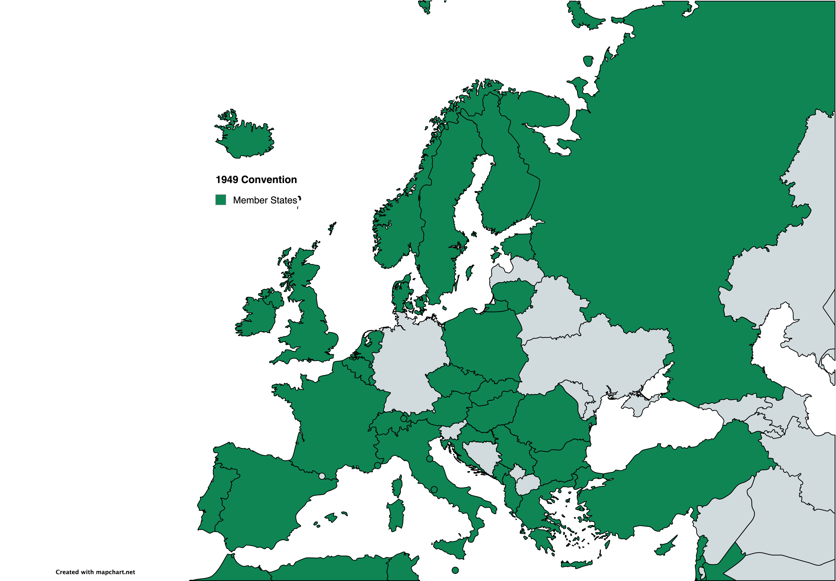
Convention on Road Traffic dated 11.09.1949
Notes:
Germany is not a member state

Slide 11
Article 4 of the Convention on Road Traffic dated 11.09.1949
H₂
"Motor vehicle" means any self-propelled vehicle normally used for the transport of persons or goods upon a road, other than vehicles running on rails or connected to electric conductors. …
?
Notes:
Rail is clearly out
Trolley seems to also be out --- but what if it is only connected to the wires for some time and not for the whole trip?
H2 does not seem to be a problem as these trucks are certainly self-propelled

Slide 12
Article 4 of the Convention on Road Traffic dated 11.09.1949
Le terme "automobile" désigne tous véhicules pourvus d'un dispositif mécanique de propulsion circulant sur la route par leurs moyens propres, …
?
H₂
Fuel Cells
www.reuters.com/business/autos-transportation/big-truckmakers-bet-hydrogen-extend-combustion-engine-life-2024-08-01/
Notes:
Is a fuel cell a mechanical propulsion?
„„Kraftfahrzeug" ist jedes mit mechanischem Antrieb und eigener Kraft auf der Straße verkehrende Fahrzeug, …“
The term “automobile” refers to any mechanically propelled vehicle travelling on the road under its own power,

Slide 13
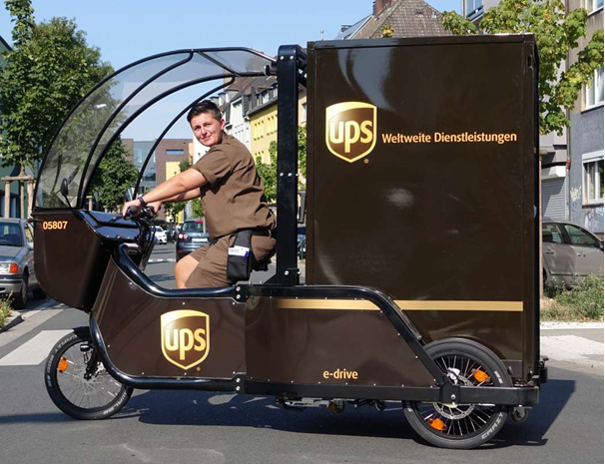
Article 4 of the Convention on Road Traffic dated 11.09.1949
"Motor vehicle" means any self-propelled vehicle normally used for the transport of persons or goods upon a road, other than vehicles running on rails or connected to electric conductors. Any State bound by annex 1 shall exclude from this definition cycles fitted with an auxiliary engine of the type described in that annex;
?
Notes:
1949 is not definive on whether bicyles with auxiliary engines are covered or not -> national law
What aboiut countries that have not signed the 1949 Convention – like Germany? These are certainly not „bound by annex 1“

Slide 14
Article 4 of the Convention on Road Traffic dated 11.09.1949
"Cycle" means any cycle not self-propelled [… non pourvu d'un dispositif automoteur …]. Any State bound by annex 1 shall include in this definition cycles fitted with an auxiliary engine of the type described in that annex;
Notes:
1949 differentiates between bio-bike and bikes with engine.
No definition for motorcycle

Slide 15
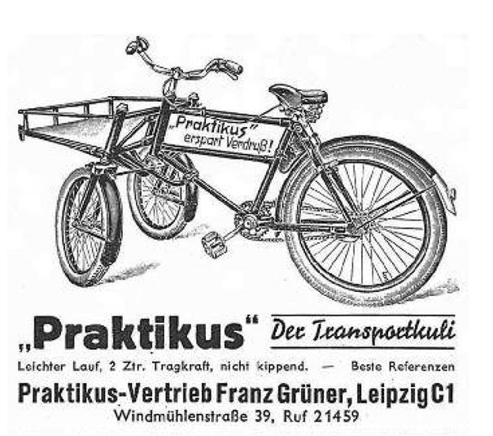
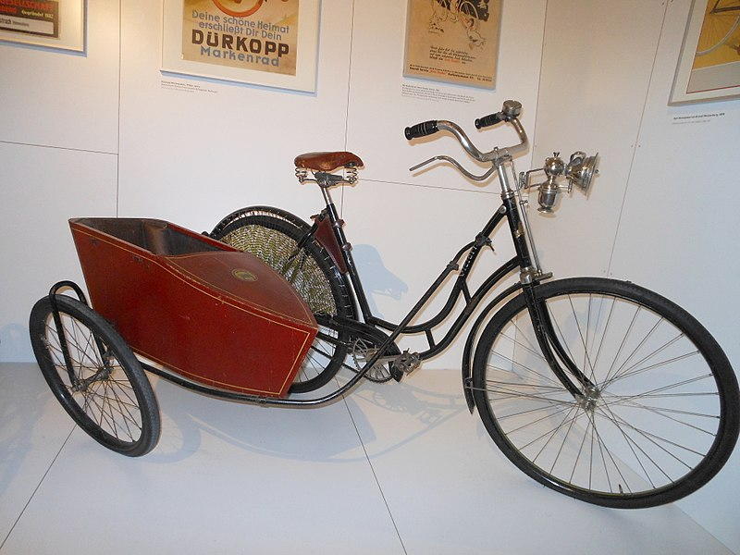
Annex 1 of the Convention on Road Traffic dated 11.09.1949
?
Cycles fitted with an auxiliary internal combustion engine [moteur auxiliaire thermique] having a maximum cylinder capacity of 50 cm³ (3.05 cu. UK) shall not be considered as motor vehicles, provided that they retain all the normal characteristics of cycles with respect to their structure.
battery
Notes:
E-power is auxiliary
But not a combustion motor -> Wide interpretation?
What is the charactericstic structure of a cycle?

Slide 16
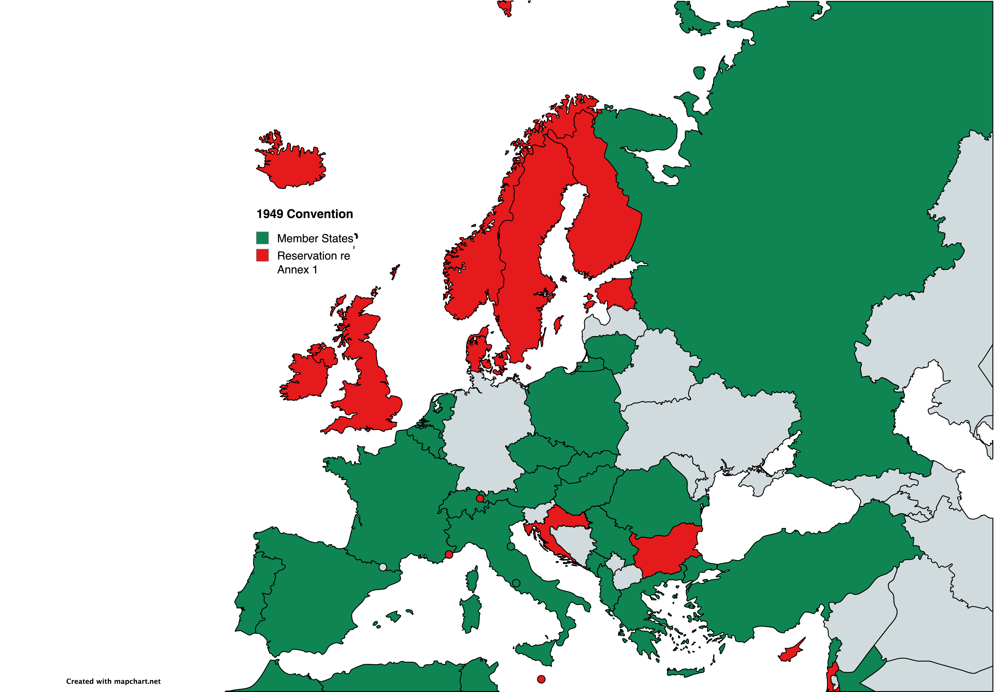
Reservations regarding Annex 1 of the 1949 Convention

Slide 17
European Agreement supplementing the 1949 Convention on road traffic and the 1949 Protocol on road signs and signals
Ad Annex 1
Cycles fitted with an auxiliary motor will not be considered as motor vehicles provided that they have the normal characteristics of bicycles as to their performance.
?

Slide 18
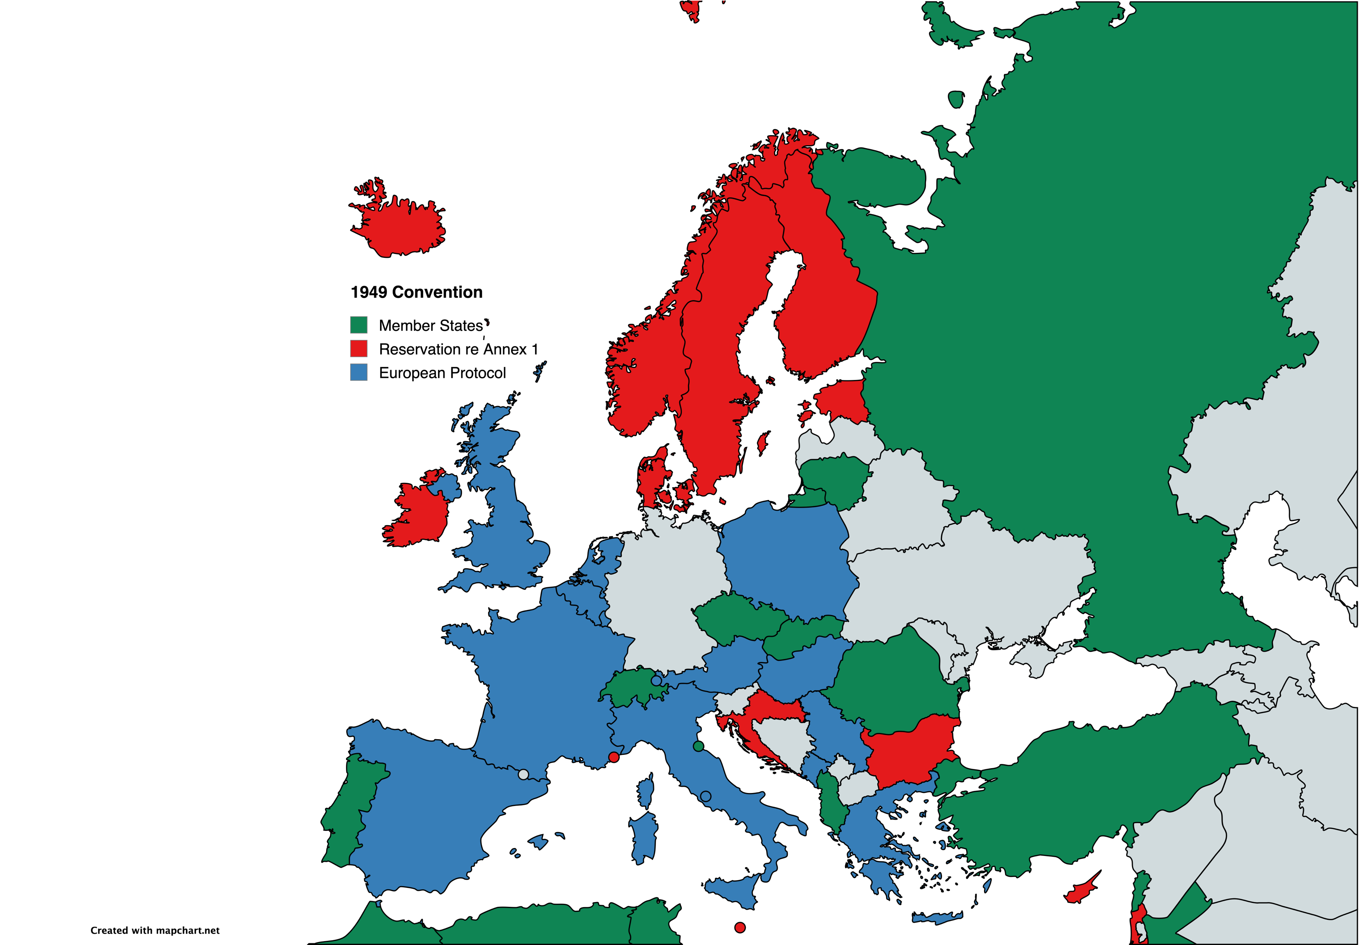
European Agreement supplementing the 1949 Convention on road traffic and the 1949 Protocol on road signs and signals
Ad Annex 1
Cycles fitted with an auxiliary motor will not be considered as motor vehicles provided that they have the normal characteristics of bicycles as to their performance.
?
Notes:
-> No limitation as to typr of motor

Slide 19
jobs.movebybike.com/departments/stockholm-riders

Slide 20
Summary for the 1949 Convention
No train or tram
Maybe trolley-truck
H2 combustion covered
H2 fuel cell unclear
E-Bike … it‘s complicated

Slide 21
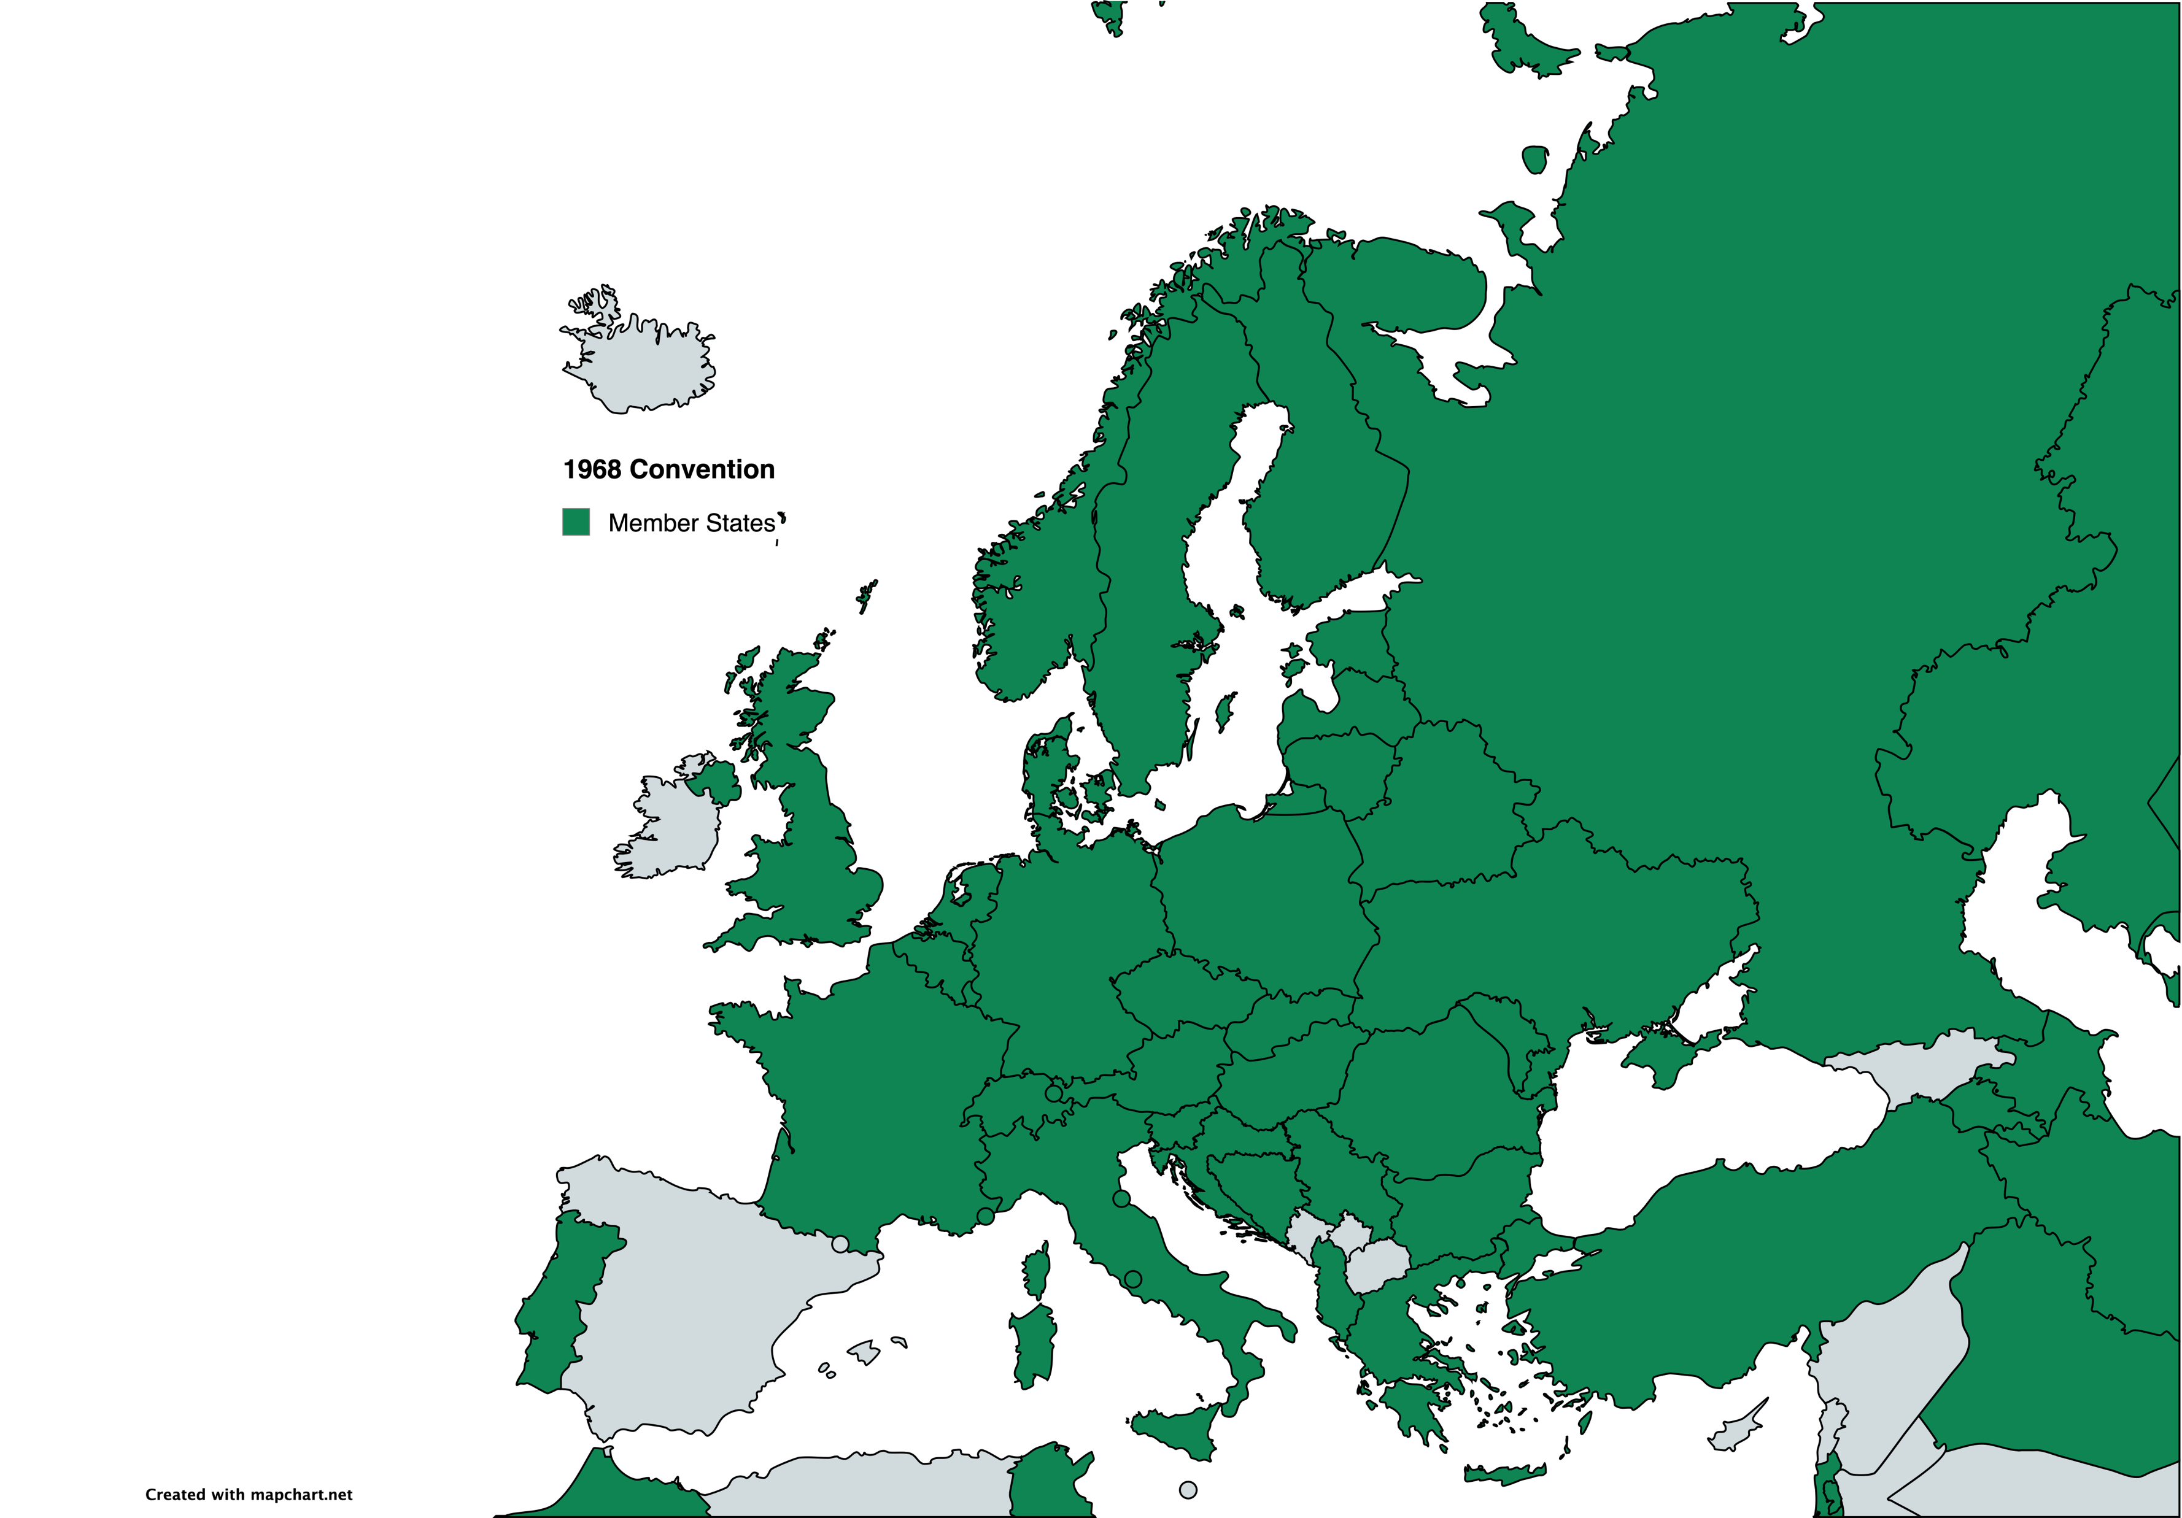
Convention on Road Traffic, Vienna, 8.11.1968
Article 48
Upon its entry into force, this Convention shall terminate and replace, in relations between the Contracting Parties, … and the Convention on Road Traffic, opened for signature at Geneva on 19 September 1949.
Notes:
Spain has signed, but not ratified the Convention, though national law makes reference to it.
This Convention is operative and updated to cover atters such as autonomous vehicles
Most, but not all CMR / 1949 Countries

Slide 22
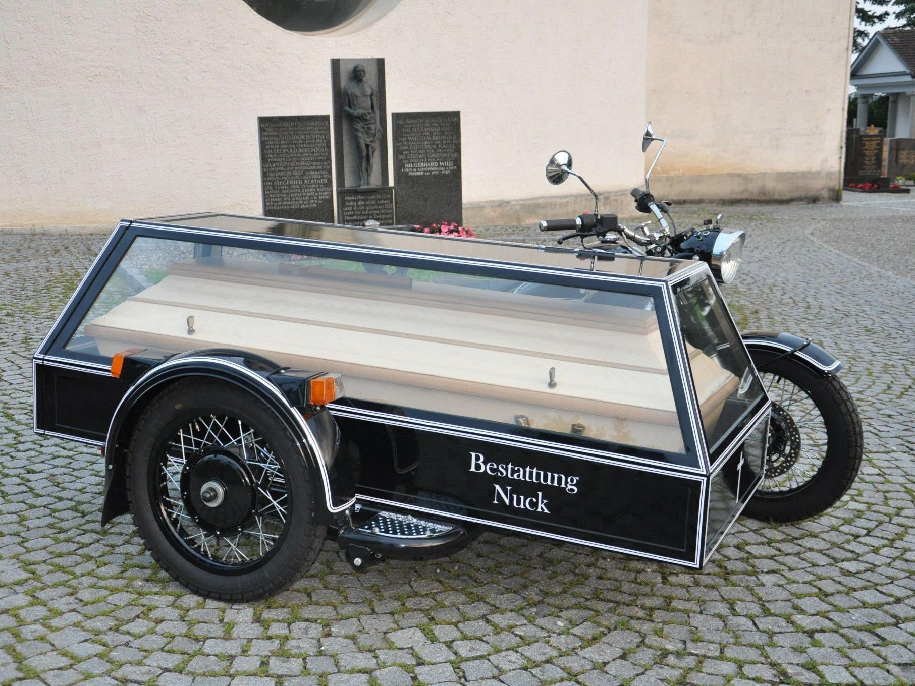
Art. 1 lit. l) - p) Convention on Road Traffic, Vienna, 8.11.1968
Can there be such a thing as a two-wheeled motor cycle with a side-car and just TWO wheels?
… unlikely.
"Cycle" means any vehicle which has at least two wheels and is propelled solely by the muscular energy of the persons on that vehicle, in particular by means of pedals or hand-cranks;
"Moped" means any two-wheeled or three-wheeled vehicle which is fitted with an internal combustion engine having a cylinder capacity not exceeding 50 cc (3.05 cu in) and a maximum design speed not exceeding 50 km (30 miles) per hour.
"Motor cycle" means any two-wheeled vehicle, with or without a side-car, which is equipped with a propelling engine. Contracting Parties may also treat as motor cycles in their domestic legislation three-wheeled vehicles whose unladen weight does not exceed 400 kg (900 lb). The term "motor cycle" does not include mopeds …
Notes:
Certainly not a cycle
Maybe a Moped, but then we have the same difficulties as a with the 1949 convention
Luckily we also have the motor cycle that does not place any limits on the propulsion type
However, it sems to be limited to who-wheeled vehicles….?

Slide 23
Art. 1 lit. l) - p) Convention on Road Traffic, Vienna, 8.11.1968
"Motor vehicle" means any power-driven vehicle which is normally used for carrying persons or goods by road or for drawing, on the road, vehicles used for the carriage of persons or goods. This term embraces trolley-buses, that is to say, vehicles connected to an electric conductor and not rail-borne.
"Power-driven vehicle" means any self-propelled road vehicle [tout véhicule pourvu d'un moteur de propulsion], other than a moped in the territories of Contracting Parties which do not treat mopeds as motor cycles, and other than a rail-borne vehicle;
Notes:
We have the Motor Cycle = Delivery Bike covered
We have the trolley bus truck covered

Slide 24
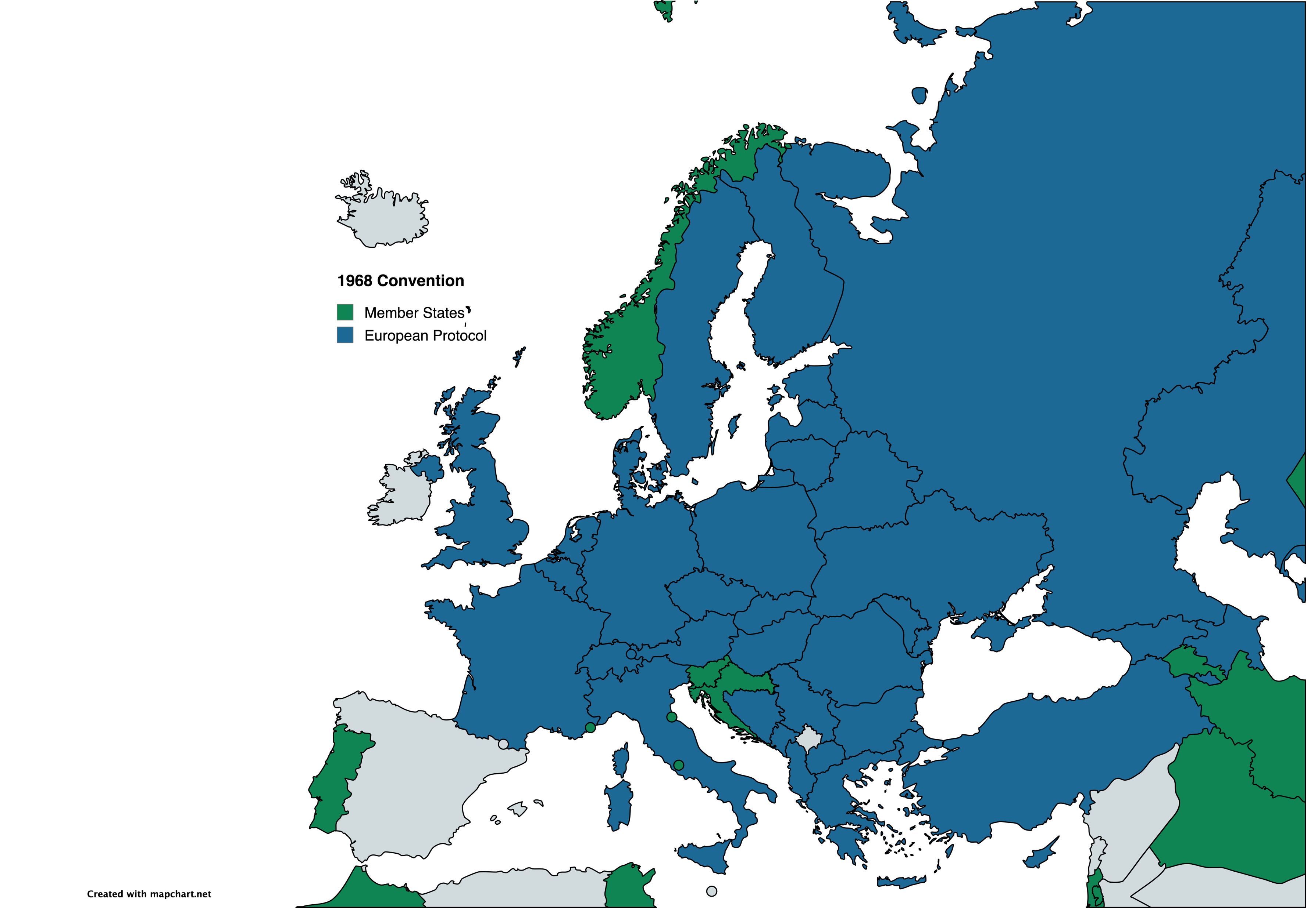
European Agreement supplementing the Convention on road traffic opened for signature at Vienna on 8 November 1968
3. Ad Art. 1 of the Convention
Sub-Paragraph (n)
Three-wheeled vehicles whose unladen mass does not exceed 400 kg (900 lb) shall be treated as motor cycles.
Notes:
Spain has signed, but not ratified the Convention, though national law makes reference to it.

Slide 25
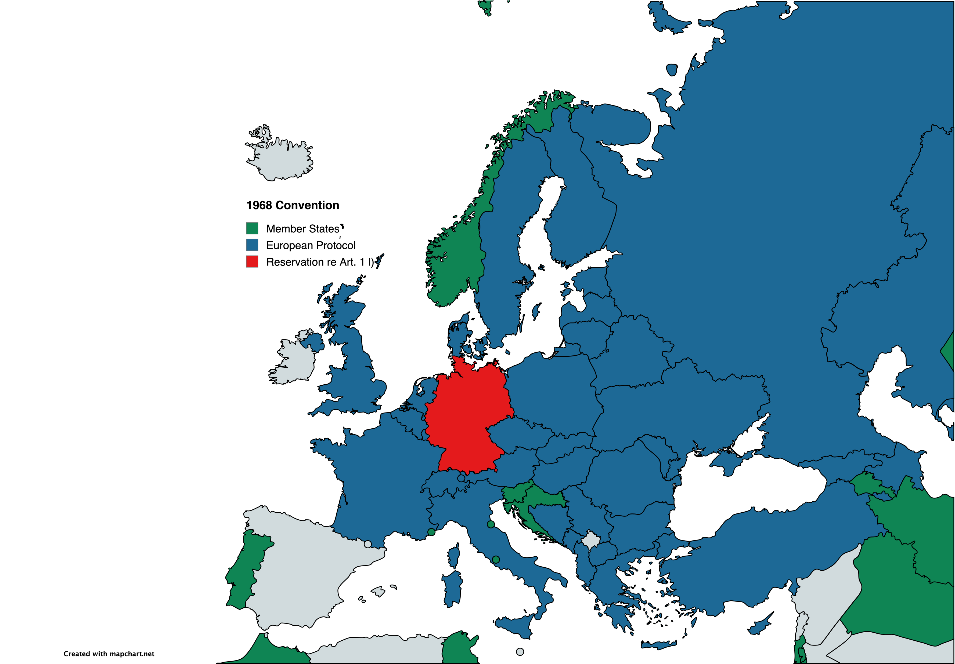
European Agreement supplementing the Convention on road traffic opened for signature at Vienna on 8 November 1968
The Federal Republic of Germany does not consider itself bound by paragraph 3 of the annex (article 1, sub-paragraph (n) of the Convention).
Notes:
Spain has signed, but not ratified the Convention, though national law makes reference to it.

Slide 26
Summary for the 1968 Convention
No train or tram
Trolley-truck covered
H2 combustion covered
H2 fuel cell covered
E-Bike probably covered

Slide 27
But…
Can Art. 1 para. 2 CMR be interpreted as referring to the 1968 Convention?
Not a dynamic reference
CMR member state does not have to be a 1949 member state
Not all CMR member states are member states of the 1968 Convention
Was the CMR not intended to cover road transport regardles of the propulsion mode?
1968 explicitly replaces 1949 as between its member states

Slide 28
Applying the 1968 Convention to CMR cases…
LG Regensburg, 28.11.1989 - S 206/89, TranspR 1990, 194: „Swap bodies do not have their own axles with wheels. They are not vehicles in the sense of the CMR, as the lower court convincingly found. Swap bodies are not the same as trailers or semi-trailers in the sense of Art. 1 lit. q) or r) of the [1968 Convention].“
This argument was followed by OLG Hamm, 02.02.1995 - 18 U 35/94, VersR 1996, 1304
OLG Hamburg, 13.03.1993 - 6 U 60/93, TranspR 1994, 193 did not follow the result of LG Regensburg but did not comment of the application of the 1986 Convention
Basedow (TranspR 1994, 338, 339) criticises the OLG Hamburg decision: „Art. 1 para. 2 [CMR] … also refers … to Art. 4 [1949] for a more detailed definition of these concepts. This Convention was later replaced by [1968], the corresponding definitions of which are contained in Art. 1 lit. o), q), r) and u). You can twist and turn those definitions however you like, but a swap body is not covered by them.

Slide 29
LG Regensburg, TranspR 1990, 194 = VersR 1990, 916

Slide 30
OLG Hamburg, TranspR 1994, 193
Der Senat sieht mit der h.M. auch eine Wechselpritsche als Kraftfahrzeug im Sinne des Art. 1 Abs. 1 CMR an, vgl. Herber, VersR 1988 S. 646 li. Sp. oben (für Wechselaufbauten), ebenso Koller, Transportrecht 2. Aufl. Art. 2 CMR Rdnr. 3 – anders allerdings unter Bezugnahme auf LG Regensburg, TranspR 1990 S. 194 in Rdnr. 5 zu Art. 1 CMR, wie hier Helm, TranspR, § 452 Anh. III Anm. 2 zu Art. 2 CMR. Für Trailer ist deren Eigenschaft als Kraftfahrzeuge im Sinne der CMR von der Rechtsprechung des BGH anerkannt, Urteil vom 14. Dezember 1988 VersR 1989 S. 309 = TranspR 1989, S. 141.
Das entspricht der Aufzählung in Art. 1 Abs. 2 CMR, die auch Anhänger und Sattelanhänger umfaßt, also nicht voraussetzt, daß das Kraftfahrzeug als Transportmittel aus eigener Kraft und ohne besondere Herrichtung den Transport zu bewirken vermag. Die für die Anwendung der CMR relevante Abgrenzung liegt vielmehr in der Unterscheidung von Beförderungs- und Verpackungsmittel. Dem entspricht es, wenn Koller a.a.O. Art. 2 CMR Rdnr. 3 Wechselaufbauten als Kraftfahrzeuge bezeichnet, Container aber nicht, weil sie nicht Teil eines Kraftfahrzeuges sein könnten. Ebenso unterscheidet Helm a.a.O. Anm. 2 zu Art. 2 CMR unter der Überschrift „Huckepackverkehr: Zu den Straßenfahrzeugen gehören auch Wechselaufbauten und Sattelauflieger, nicht dagegen Container und Paletten.“

Slide 31
Basedow, TranspR 1994, 338, 339
So liegen die Dinge aber nicht. Art. 1 Abs. 2 legt nicht nur durch eine abschließende Aufzählung fest, daß Kraftfahrzeuge, Sattelfahrzeuge, Anhänger und Sattelanhänger „Fahrzeuge“ im Sinne des Übereinkommens sind, sondern verweist auch noch in einem wahren Definitionsexzeß zur näheren Bestimmung dieser Unterbegriffe auf Art. 4 des Abkommens über den Straßenverkehr vom 19. September 1949. An die Stelle dieses Abkommens ist später das Übereinkommen vom 8. November 1968 über den Straßenverkehr getreten, dessen entsprechende Definitionen in Art. 1 lit. o), q), r) und u) enthalten sind. Man mag jene Definitionen drehen und wenden wie man will, eine Wechselpritsche fällt nicht darunter.

Slide 32
OLG Hamm, VersR 1996, 1304
Eine Wechselbrücke ist jedenfalls kein Fahrzeug im Sinne der ADSp und der CMR, denn eine Wechselbrücke hat keine eigenen Achsen mit Rädern (vgl. LG Regensburg TranspR 90, 194 und Senat vom 18. 12. 1989 - 18 U 57/89 -; a. A. OLG Hamburg, TranspR 94, 193). Ähnlich wie bei Paletten und Containern, die zwischen Spediteuren und Frachtführern getauscht werden, kann es auch beim Einsatz von Wechselbrücken vom Zufall abhängen, ob der Transport im konkreten Fall mit einer eigenen Wechselbrücke des Spediteurs oder mit einer Wechselbrücke eines anderen Unternehmers durchgeführt wird, denn Wechselbrücken werden häufig unter Spediteuren und Frachtführern ausgeliehen. Ein solcher Zufall kann nicht über die Anwendung der CMR entscheiden. Kommt eine eigene Wechselbrücke zum Einsatz, ergibt sich daraus für den Spediteur ebensowenig eine Obhut über das Frachtgut wie in dem Fall, daß eigene Container oder Paletten benutzt werden. Aus diesem Grund ist es nicht gerechtfertigt, Wechselbrücken zu den Fahrzeugen i. S. v. Art. 2 Nr. 1 CMR zu zählen.

Slide 33
CMR + 1949

Slide 34
Fazit?
Fahrrad vs Kraftfahrzeug
1949 vs 1968
CMR vs Beförderungsmittel

Slide 35
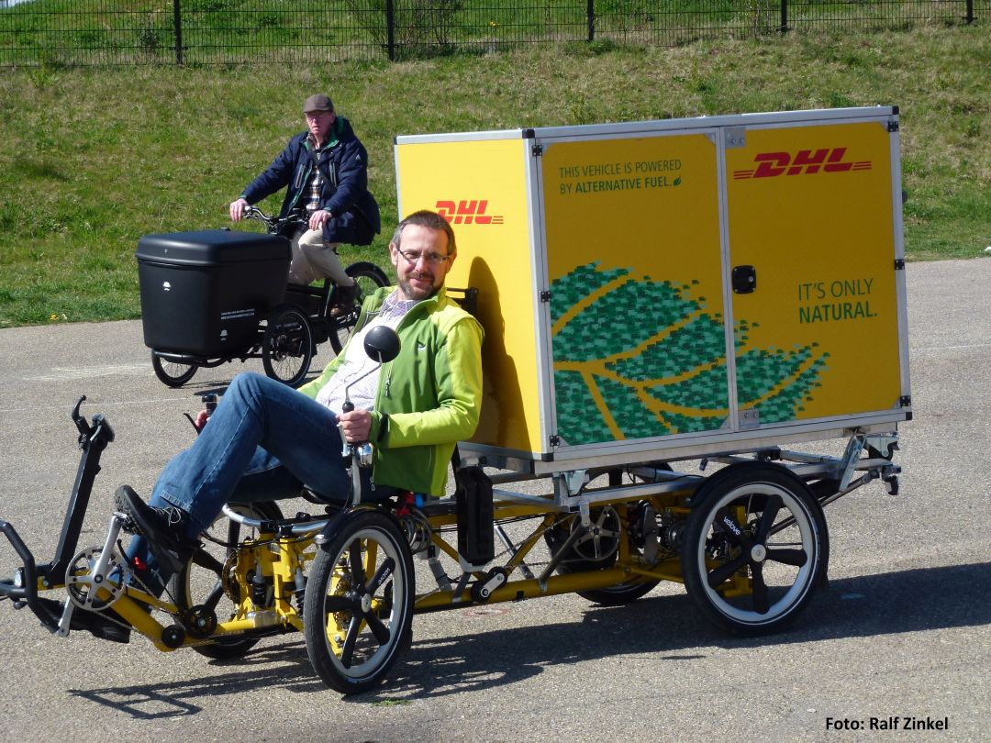

Slide 36
Vielen Dank für Ihre Aufmerksamkeit!
Dr. Tobias Eckardt
Ahlers & Vogel Rechtsanwälte PartG mbB
Hafenstraße 6
26789 Leer
leer@ahlers-vogel.de
www.ahlers-vogel.de

Slide 37
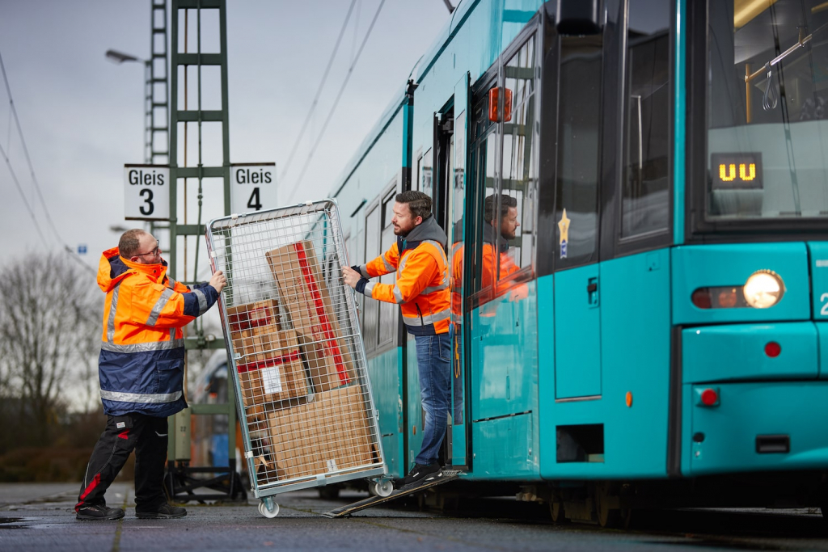
https://innovation.vgf-ffm.de/gueter-tram/

Slide 39
Überschrift Verdana 24pt Folie mit großem Bild

Slide 40
Überschrift Verdana 24pt Folie großes Textfeld
Text in Georgia 20pt

Slide 41
Überschrift Verdana 24pt Folie Inhalt und Bild
Text Georgia 20pt
Conet deliciduciis etusam
Experrum ne nonsequate necatus si quibusa nici ut fugias et magnatem eos doluptat que dolum
Aaut et volorat ad quo erehend emporis que adi del et vendae dolesequae ra

Slide 42
Thank you!
Hochschule Bremerhaven
T +49 471 4823-0
W www.hs-bremerhaven.de
Prof. Dr. Tobias Eckardt
E teckardt@hs-bremerhaven.de

